Slide 1
RFID Attendance Tracking
Rick Bielski, James Jerger, Kevin Zheng

Slide 2
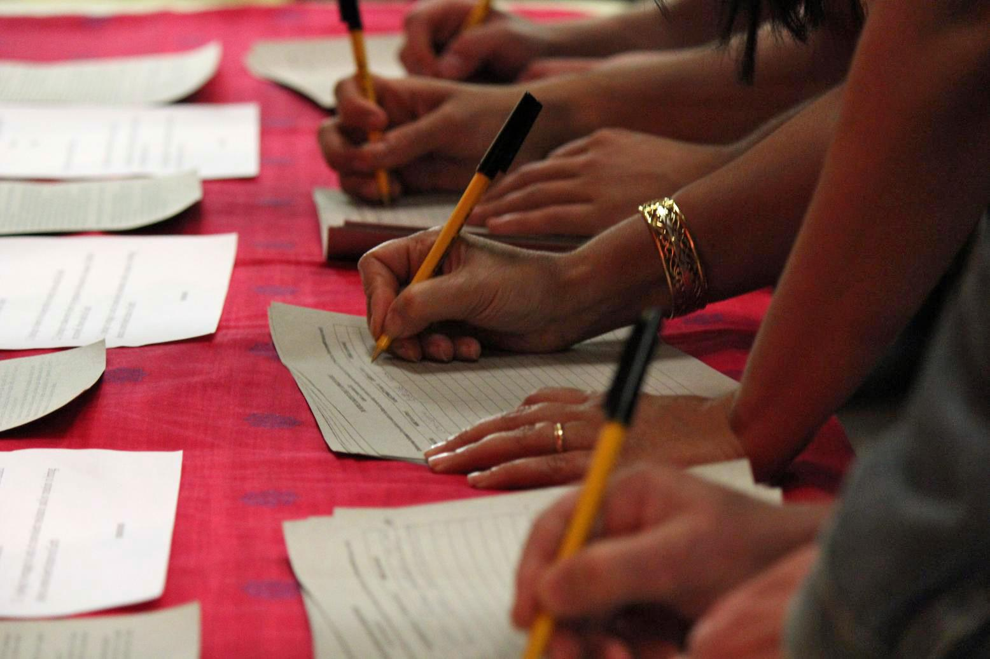
The Problem
Currently classes don’t have a quick and efficient attendance tracking system.
Attendance is currently mostly taken on paper which increases chances of getting lost and students can feign attendance in class.

Slide 3
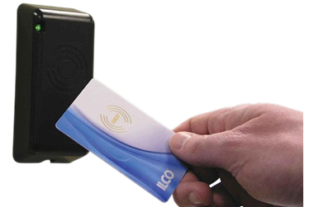
The Solution
Create an RFID scanner that will read ID’s and submit data through an Arduino Uno to a MySQL database.

Slide 4

The Solution Cont.
2. This database will be accessed by an Apache server to display back on a website information about the given student, (Picture, Name, ID, etc.)

Slide 5

The Solution Cont.
3. Attendance information is displayed in real time and it offers a way to track attendance throughout the semester.

Slide 6

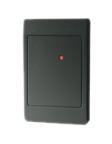
How Does it all Work?

Slide 7
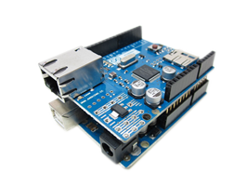
Physical Components and Logic
Arduino Uno with Ethernet Shield
Connected to RFID scanner.
Reads ID’s and translates into serial.
Sends serial to .php server via ethernet.

Slide 8


How Does it all Work?

Slide 9

MySQL Logic
MySQL Server Database stores information from ID’s in tables to be accessed by the web server.
Hosted on Amazon Web Services.
HTML web page and Arduino interface with SQL through .php.
Stores information sent from Arduino.
Allows web page to retrieve information.

Slide 10
How Does it all Work?

Slide 11
Apache Web Server Logic
Displays information from database to user (instructor) based on RFID.
Hosted on Amazon Web Services.

Slide 12
How Does it all Work?

Slide 13
HTML Website Interface
Web page polls the database and displays new scans as they come in.
Professor can easily see who is scanning in.
Self-refreshing to keep professor up to date.
If the student’s ID is not found in the database, the professor has the ability to add the student to the database.

Slide 14
Conclusion
Will replace outdated and ineffective attendance system.
No more paper.
Unique ID’s which make forging attendance impossible.
Simple and easy to use for both students and faculty.
Future Improvements
Absence counter.
Attendance tracking over time for advising.
Photo ID displayed on screen.
More user friendly UI.

Slide 15
Demo
http://aws.kzheng.org

Slide 16
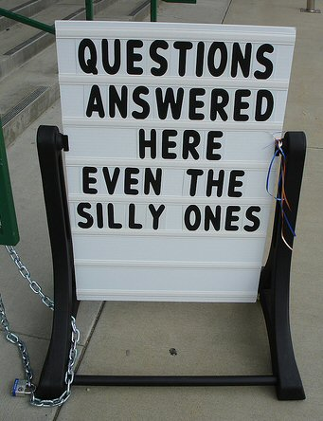
Questions?

